Slide 1
Opening a sushi restaurant in manhattan
A Coursera Capstone Project presentation
May 2019

Slide 2
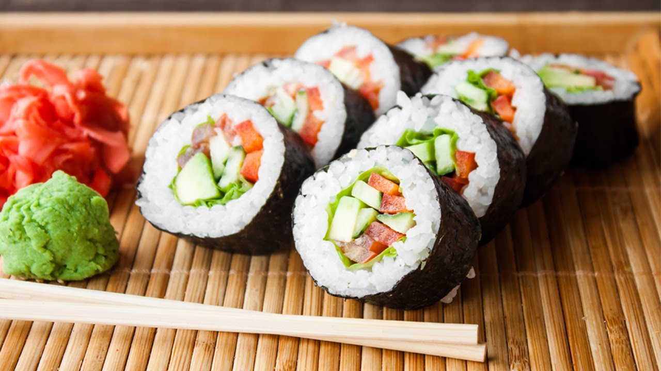
Introduction

Slide 3
Business problem
when opening a new restaurant, especially in a large city like New York, or part of it like Manhattan, a business person has a problem of determining the optimal location.
Many factors influence the future success (or failure) of a restaurant: vicinity of competitors, crime rate in that neighborhood, surrounding venues, number of residents in that neighborhood, their average income etc.
Taking all of these variables into account would surely provide a more precise analysis, but for this project we will only be using th surrounding competitors – e.g. the number and location of other sushi restaurants in Manhattan

Slide 4
Target audience and data
Target audience: entrepreneurs looking to open a sushi restaurant in Manhattan, or any other city or neighborhood.
Data which we will be using is the following:
New York City neighborhoods list (already provided externally earlier in the course),
Geographical coordinates of NYC neighborhoods,
Foursquare API location data on most popular NYC (and Manhattan) venues and restaurants.

Slide 5
Methodology

Slide 6
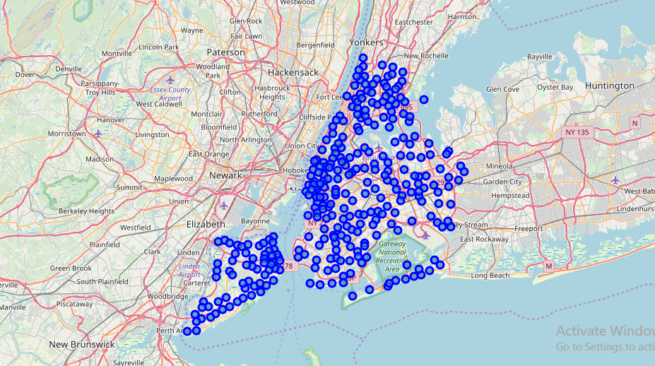
First steps...
The first thing I did was import all of the libraries needed to work with datasets, map visualizations and Foursquare. The I downloaded the NYC neighborhoods dataset. Since this dataset was in JSON format, I had to make a new dataframe with the columns Borough, Neighborhood, Latitude, Longitude. The good thing about this dataset is that it already contains geographical coordinates, so we don't have to deal with that.
Visualizing NYC neighborhoods:

Slide 7
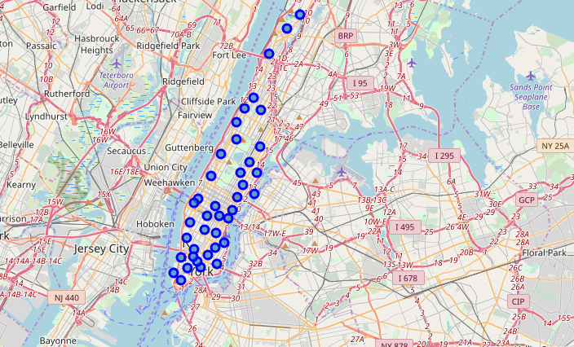
I concentrated only on Manhattan
Mapping Manhattan neighborhoods:

Slide 8
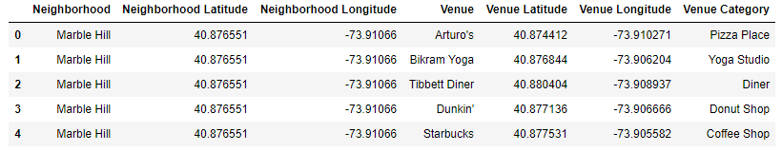
Using Foursquare API
With the help of the Foursquare API, I found the top 10 venues in every neighborhood, among which were Sushi Restaurants.

Slide 9
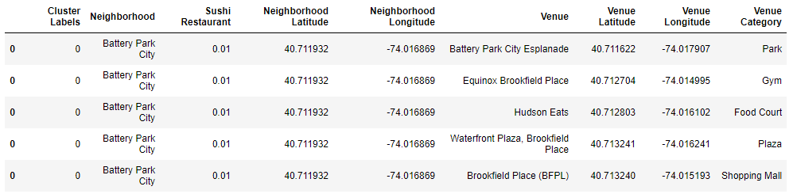
K-means clustering
By using K-means clustering, I got 5 different clusters based on the number of sushi restaurants in the neighborhood. The final merged dataset contained Cluster Labels, along with one-hot encoded values for Sushi Restaurants. It also had geo coordinates and top venues.

Slide 10
The clusters
Clusters 0, 1, 2, 3 and 4 are all unique in their own way:
Cluster 0: little to no sushi restaurants, with neighborhoods full of gyms, pizza places, parks and stores,
Cluster 1: the most sushi restaurants, with many other types of restaurants tightly grouped together (Italian, German, Thai, Vietnamese), along with hotels and coffee shops,
Cluster 2: medium number of sushi restaurants, with also many other international restaurants (Italian, Japanese, Indian), dance studios, gyms, Gourmet shops, Jazz clubs – all in all this is a vibrant and upper-class part of Manhattan,
Cluster 3: the cluster with the least number of sushi restaurants, with a lot of stores, coffee shops, cultural places and a few restaurants – some of them being local and some being international,
Cluster 4: another cluster with a high number of sushi restaurants, along with other international restaurants, bars, gyms, spas and coffee shops.

Slide 11
Discussion and conclusion
The clusters I got in my analysis are all different, and some are not at all good locations for a sushi restaurants, while others have the potential.
After examining all the clusters, I came to the conclusion that Cluster 3 has the smallest number of sushi restaurants, and cluster 1 has the most. If an entrepreneur wants to open a sushi place where there is not much competition, he should choose to open it in one of the neighborhoods belonging to Cluster 3, which could be Soho, for example, where many high-end restaurants exists, but also places that attract tourists such as shops, art galleries and museums.
Conclusion
Of course, the results of this analysis are limited because only factor was taken into account (the number of sushi restaurants). Other factors, such as the crime rate, population, average income etc. could make for a better analysis.

Slide 12
Thank you! ☺

